Slide 1

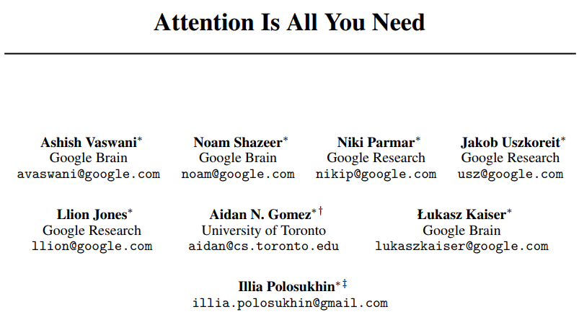
Attention Is All You Need Muhammad Umar Salman umar.salman@mbzuai.ac.ae
NIPS 2017

Slide 2
Agenda
Motivation
Summary
Strengths
Weaknesses
Methodology
2

Slide 3
Motivation
Summary
Strengths
Weaknesses
Methodology
Motivation
In S2S problems e.g. Neural Machine Translation, RNN with Encoder + Decoder architecture was the go-to solution.
However, working with long sequences, the architecture loses its ability to retain information from first elements.
Decoder has access to last hidden state of Encoder stack making it lose or forget early information, for this reason Attention Mechanism was introduced.
The decoder now looks at all the states of the encoder, being able to access information about all the elements of the input sequence.
3

Slide 4
Motivation
Summary
Strengths
Weaknesses
Methodology
Summary
Transformers, first sequence transduction model replacing recurrent layers used in Encoder-Decoder architecture to Multi-head self-attention.
Its architecture makes use of stacked self-attention and point-wise, fully connected layers
Experiments on WMT-2014 datasets (En-Fr & En-Ger) show that this approach achieves higher BLEU score compared to previous models or reported ensembles
Approach has had significant impact on introducing new state-of-the-art language models and vision models such as BERT, GPT-2 and ViT.
Observed Transformer generalized well when applied to other tasks such as English constituency parsing.
4

Slide 5
Motivation
Summary
Strengths
Weaknesses
Methodology
Strengths
Propose a novel architecture based on Attention Mechanism
Established a new state-of-the-art BLEU score on machine translation tasks
The architecture is highly efficient as architecture reduces model complexity which reduces the training cost
Achieves parallelizability within the architecture to speed up training.
Well-written, well-structured and experiments are clearly set-up for replication purposes.
5

Slide 6
Motivation
Summary
Strengths
Weaknesses
Methodology
Weaknesses
O(n^2.d), larger the input the higher the time it will take to make inferences/train.
Paper lacks in-depth mathematical and methodological details by giving a high overview. Reader has to go over code to fully understand the nitty-gritty details.
Paper argues that retains information for long input sequences. It should have maybe specifically evaluated on longer sequences and its compare it with other models
Although Tables are very well formatted table column names should be properly described in the footnote of the image for ease of the reader.
6

Slide 7
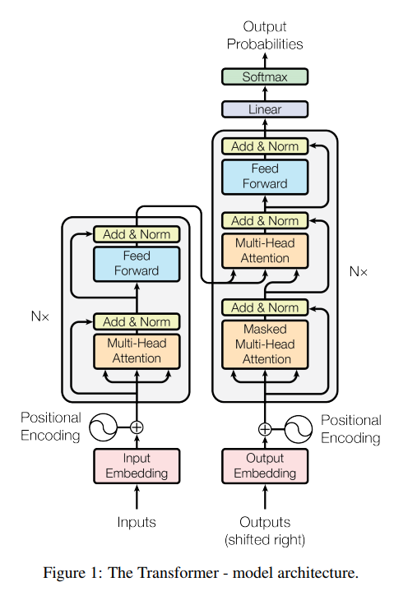
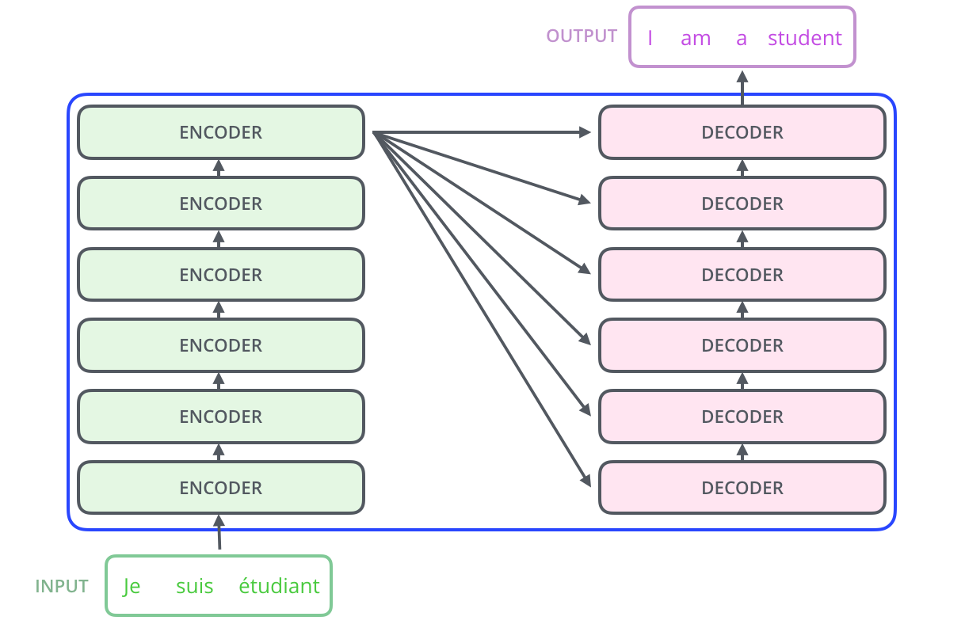
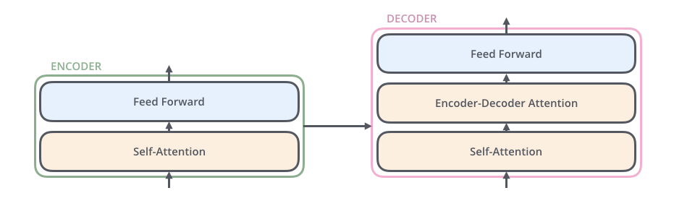
Motivation
Summary
Strengths
Weaknesses
Methodology
Methodology
General Architecture
7

Slide 8
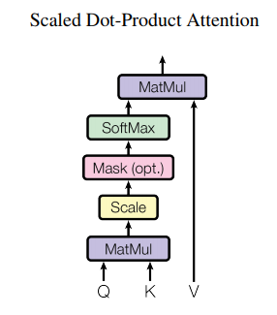
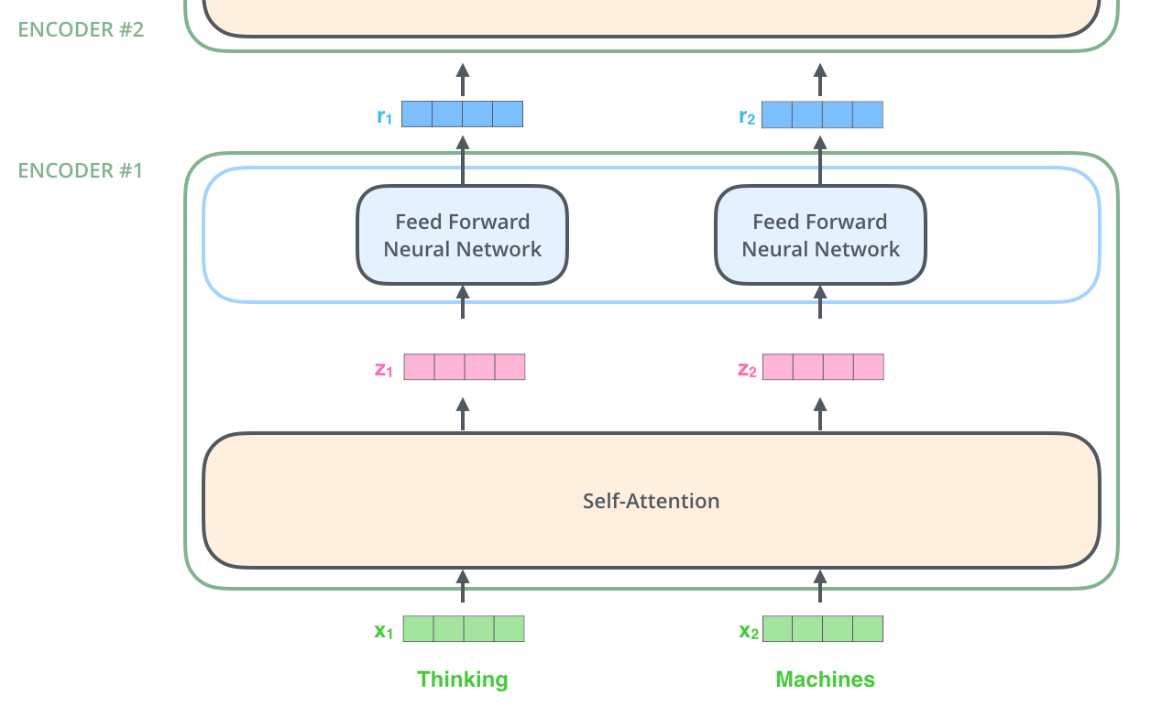
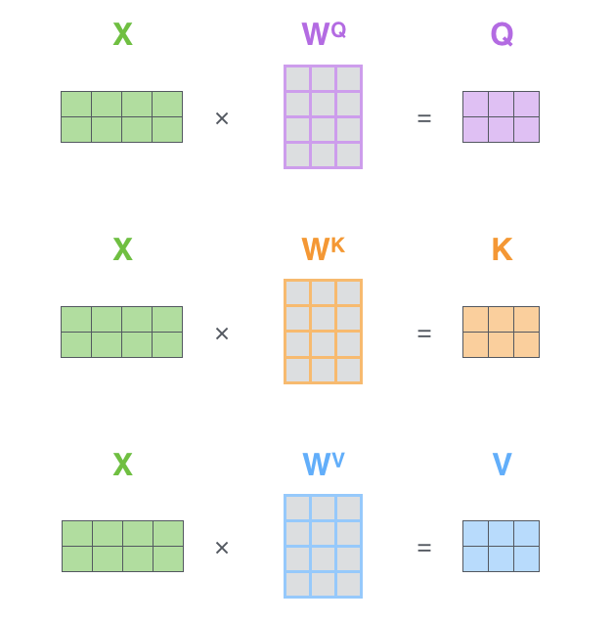

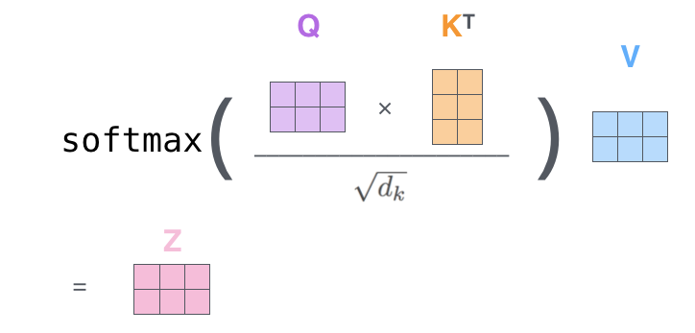

Motivation
Summary
Strengths
Weaknesses
Methodology
Methodology
Embedding + Positional Encoding
Self Attention /
Attention Score /
Attention Head
Key, Value & Query
8

Slide 9
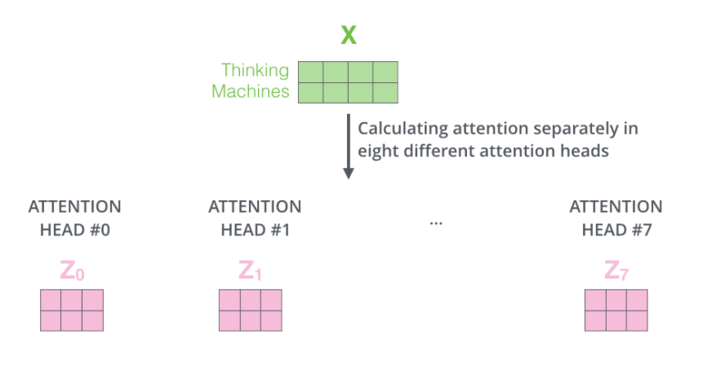
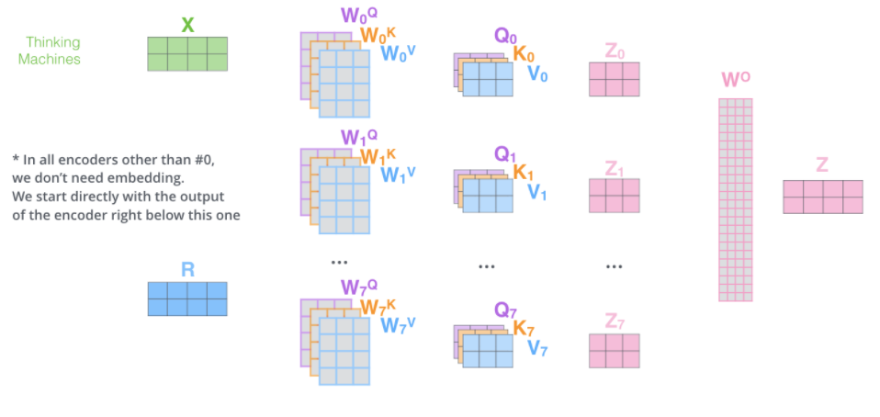
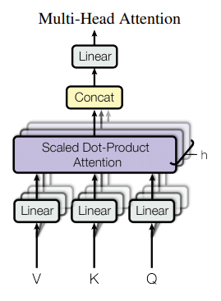
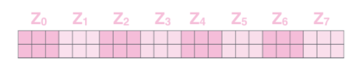

Motivation
Summary
Strengths
Weaknesses
Methodology
Methodology
Multi-Head Attention
9

Slide 10
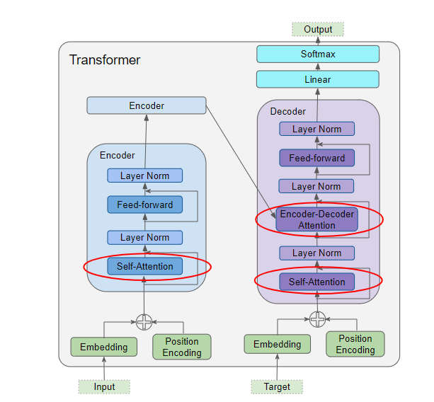
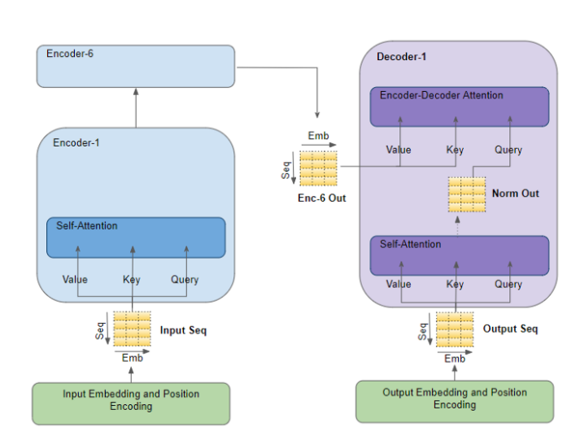
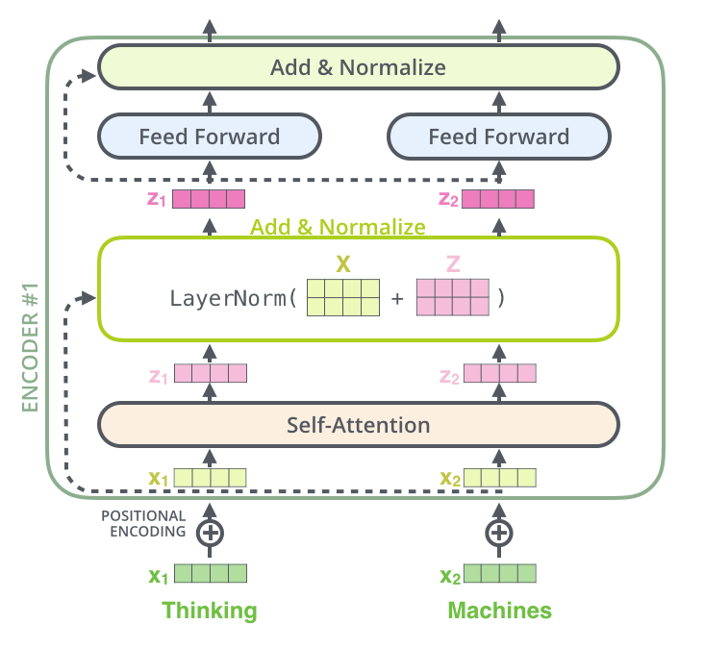

Motivation
Summary
Strengths
Weaknesses
Methodology
Methodology
Encoder Decoder
10

Slide 11
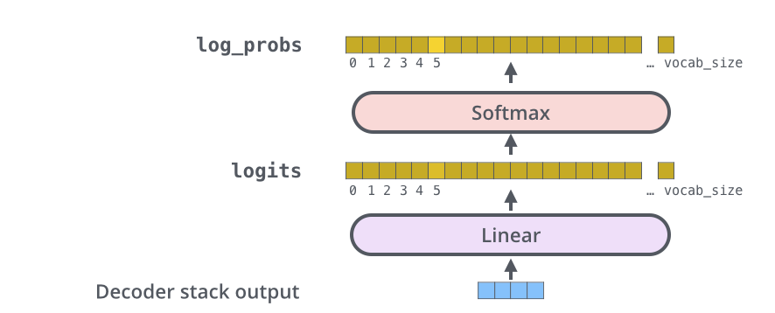
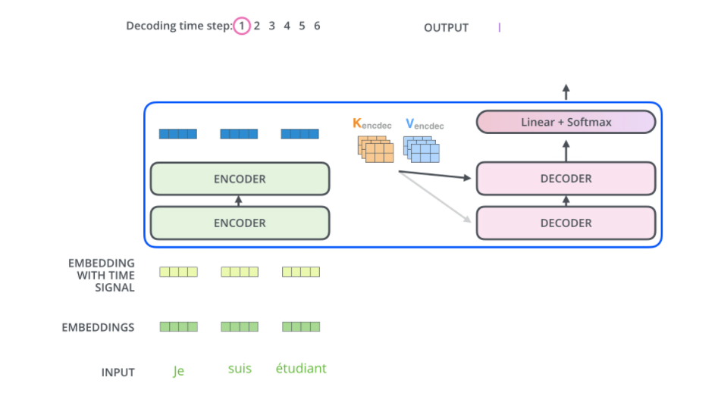
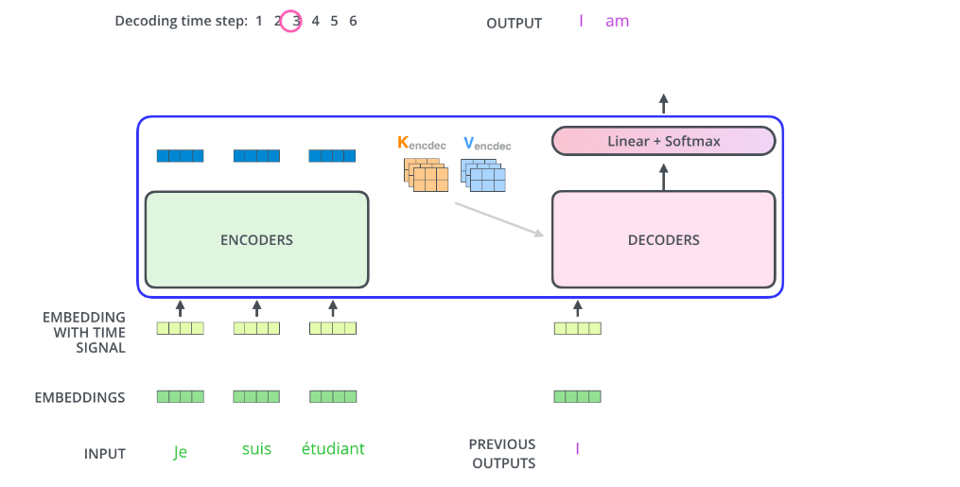
Motivation
Summary
Strengths
Weaknesses
Methodology
Methodology
Inference
11

Slide 12
Thank you
Muhammad Umar Salman
umar.salman@mbzaui.ac.ae

